Slide 1
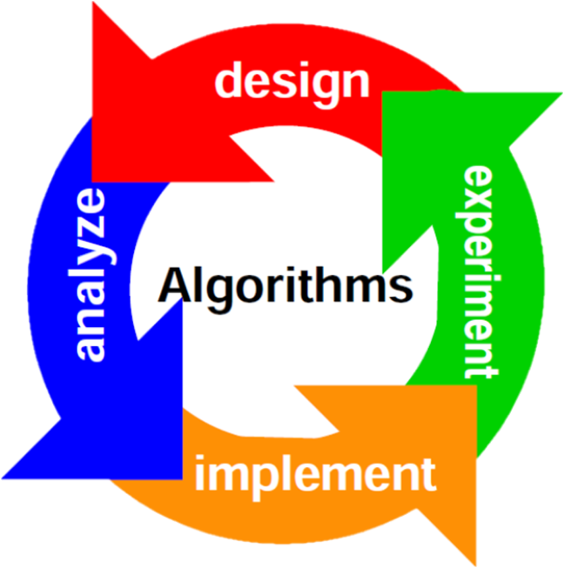
Basic Algorithms
Recursion, Greedy, Sorting and Searching
SoftUni Team
Technical Trainers
Software University
http://softuni.bg

Slide 2
Table of Contents
Recursion
Greedy
Sorting
Bubble Sort
Searching
Linear
Binary

Slide 3
Have a Question?
sli.do
#java-fund

Slide 4
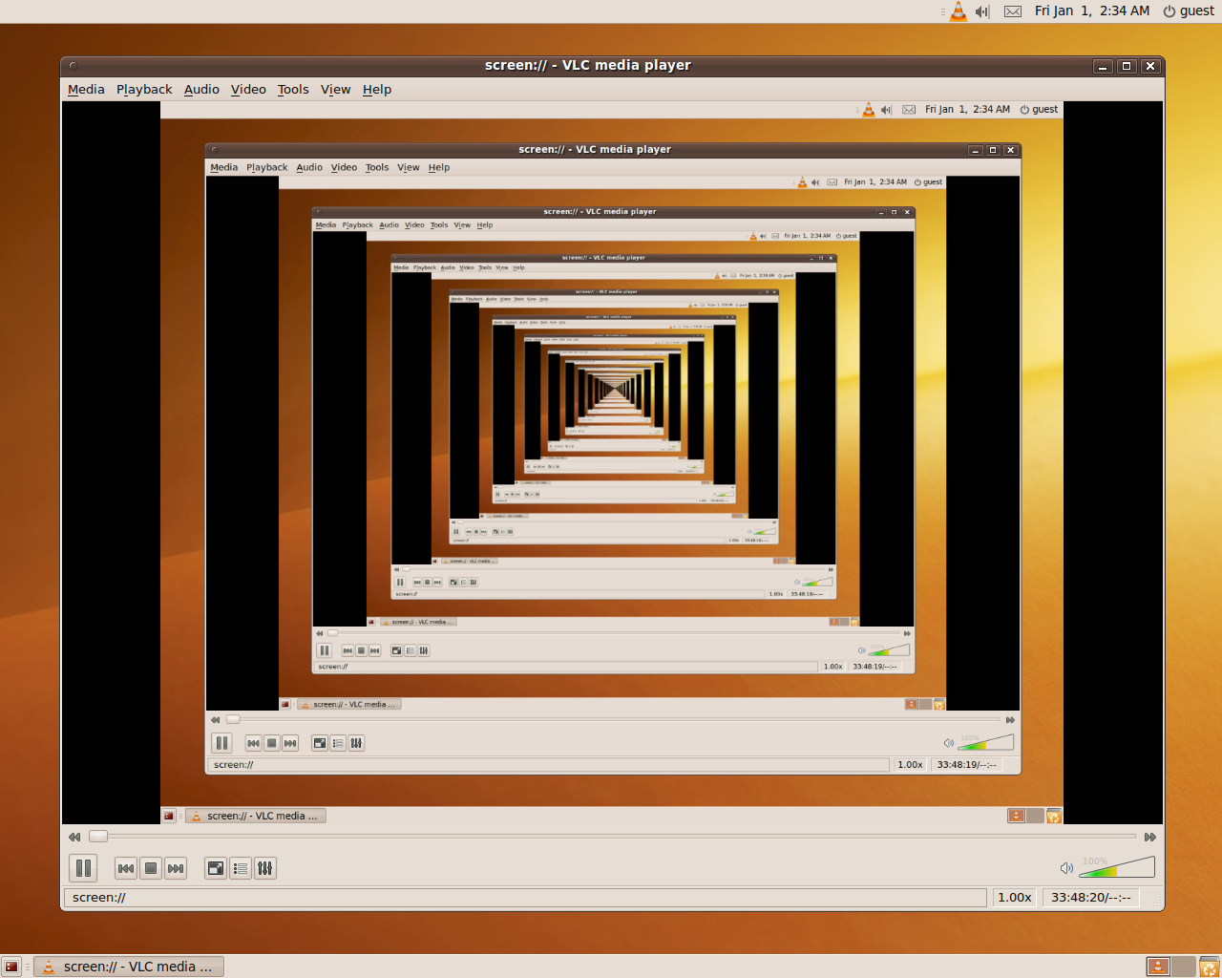
Recursion
What is Recursion?

Slide 5
What is Recursion?
Problem solving technique (In CS)
Divides a problem into subproblems of the same type
Involves a function calling itself
The function should have a base case
Each step of the recursion should move towards the base case
sum(array)
array[0] + sum(sub-array)
1 | 2 | 3 | 4 | 5
1
2 | 3 | 4 | 5

Slide 6
Array Sum – Example
sum(n - 1)
1
2 | 3 | 4
sum(n)
sum((n – 1) - 1)
1 | 2 | 3 | 4
1
2
3 | 4
sum(((n – 1) - 1) – 1)
1
2
3
4
Base case

Slide 7
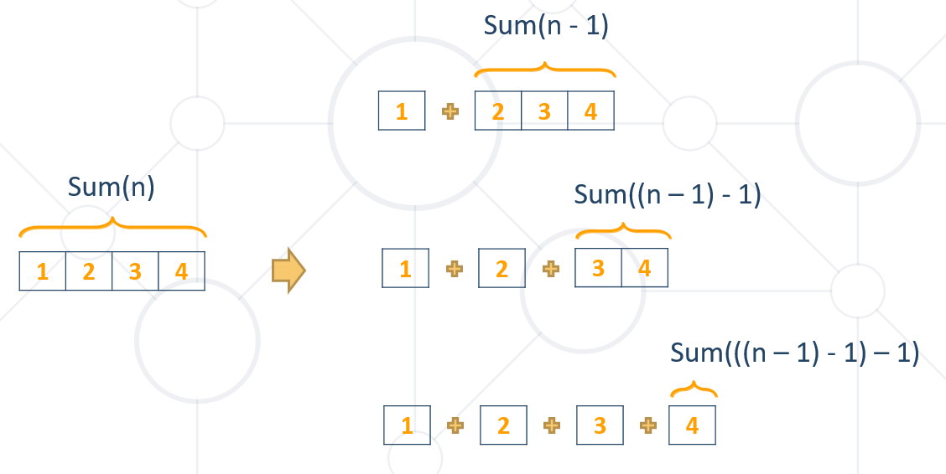
Problem: Array Sum
Create a recursive method that
Finds the sum of all numbers stored in an int[] array
Read numbers from the console
1 2 3 4
10
-1 0 1
0

Slide 8
Solution: Array Sum
public static int sum(int[] array, int index) {
if (index == array.length - 1) {
return array[index];
}
return array[index] + sum(array, index + 1);
}

Slide 9
Direct and Indirect Recursion
Direct recursion
A method directly calls itself
Indirect recursion
Method f calls f1, method f1 calls f
Or even f → f1 → f2 → f
void f() {
…
f();
}
void f() {
…
f1();
}
void f1() {
…
f();
}

Slide 10
Recursion Pre-Actions and Post-Actions
Recursive methods have 3 parts:
Pre-actions (before calling the recursion)
Recursive calls (step-in)
Post-actions (after returning from recursion)
static void Recursion() { // Pre-actions
Recursion();
// Post-actions }

Slide 11
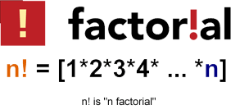
Recursive Factorial – Example
Recursive definition of n! (n factorial):
n! = n * (n–1)! for n > 0
0! = 1
5! = 5 * 4!
4! = 4 * 3!
3! = 3 * 2!
2! = 2 * 1!
1! = 1 * 0!
0! = 1

Slide 12
Problem: Recursive Factorial
Create a recursive method that calculates n!
Read n from the console
5
120
10
3628800

Slide 13

Recursion
Live Demo

Slide 14

Brute-Force Algorithms
Trying All Solutions

Slide 15
Brute-Force Algorithms
Trying all possible combinations
Picking the best solution
Usually slow and inefficient
0
0
0
0
0

Slide 16
Brute-Force Algorithms
0
0
0
0
0

Slide 17
Brute-Force Algorithms
0
0
0
0
1

Slide 18
Brute-Force Algorithms
0
0
0
0
2

Slide 19
Brute-Force Algorithms
0
0
0
0
3

Slide 20
Brute-Force Algorithms
0
0
0
1
0

Slide 21
Brute-Force Algorithms
9
9
9
9
8

Slide 22
Brute-Force Algorithms
9
9
9
9
9

Slide 23
Brute-Force Algorithms
9
9
9
9
9
10 x 10 x 10 x 10 x 10 = 100,000 combinations

Slide 24

Greedy Algorithms
Picking Locally Optimal Solution

Slide 25
Optimization Problems
In computer science, an optimization problem is the problem of finding the best solution from all feasible solutions
Finding the optimal among many candidates
Examples of optimization problems:
Find the shortest path from Sofia to Varna on the map
Find the maximum increasing subsequence in integer sequence
Traveling salesman problem (minimal Hamilton cycle)
Find the shortest route that visits each city and returns to the origin city

Slide 26
Greedy Algorithms
Greedy algorithms are a category of algorithms
For solving optimization problems
Usually more efficient than the other algorithms
But can produce non-optimal (incorrect) result
Greedy algorithms pick the best local solution
Pick the optimum from their current position & point of view
Greedy algorithms assume always choosing a local optimum leads to the global optimum
This is sometimes correct, but sometimes it is not

Slide 27
1$
1¢
50¢
5¢
25¢
4¢
Sum of Coins
Problem

Slide 28
Greedy Algorithms: Sum of Coins
Consider the US currency coins:
{ 0.01, 0.02, 0.05, 0.10}
Problem "Sum of Coins":
Gather a sum of money, using the least possible number of coins
Greedy algorithm for "Sum of Coins":
Take the largest coin while possible
Then take the second largest
Etc.

Slide 29
Sum of Coins Visualization
Target: 18
10¢
5¢
2¢
1¢
10¢
5¢
2¢
1¢
Actual:
0

Slide 30
Sum of Coins Visualization
Target: 18
10¢
5¢
2¢
1¢
5¢
2¢
1¢
Actual:
10
10¢

Slide 31
Sum of Coins Visualization
Target: 18
10¢
5¢
2¢
1¢
2¢
1¢
Actual:
15
10¢
5¢

Slide 32
Sum of Coins Visualization
Target: 18
10¢
5¢
2¢
1¢
1¢
Actual:
17
10¢
5¢
2¢

Slide 33

Sum of Coins Visualization
Target: 18
10¢
5¢
2¢
1¢
Actual:
18
10¢
5¢
2¢
1¢

Slide 34
Greedy Algorithm for Sum of Coins
Live Demo

Slide 35
Sum of Coins – Solution
int finalSum = 18;
int currentSum = 0;
int[] coins = { 10, 10, 5, 5, 2, 2, 1, 1 };
ArrayDeque<Integer> result = new ArrayDeque<Integer>();
// Next Slide
System.out.println("Sum not found");

Slide 36
Sum of Coins – Solution(2)
for (int i = 0; i < coins.length; i++) {
if (currentSum + coins[i] > finalSum) {
continue;
}
currentSum += coins[i];
resultCoins.Enqueue(coins[i]);
if (currentSum == finalSum)
// Sum Found
}

Slide 37


Greedy Failure Cases
Greedy Algorithms Often Fail

Slide 38
Sum of Coins Failure
Target: 18
10¢
5¢
4¢
1¢
10¢
5¢
4¢
1¢
10¢
5¢
4¢
1¢
Actual:
0

Slide 39
Sum of Coins Failure
Target: 18
10¢
5¢
4¢
1¢
10¢
5¢
4¢
1¢
5¢
4¢
1¢
Actual:
10
10¢

Slide 40
Sum of Coins Failure
Target: 18
10¢
5¢
4¢
1¢
10¢
5¢
4¢
1¢
4¢
1¢
Actual:
15
10¢
5¢

Slide 41
Sum of Coins Failure
Target: 18
10¢
5¢
4¢
1¢
10¢
5¢
4¢
1¢
4¢
Actual:
16
10¢
5¢
1¢

Slide 42
Sum of Coins Failure
Target: 18
10¢
5¢
4¢
1¢
10¢
5¢
4¢
4¢
Actual:
17
10¢
5¢
1¢
1¢

Slide 43
Sum of Coins Failure
Target: 18
10¢
5¢
4¢
10¢
5¢
4¢
4¢
Actual:
18
10¢
5¢
1¢
1¢
1¢

Slide 44

Sum of Coins Failure
Target: 18
10¢
5¢
1¢
1¢
1¢
10¢
4¢
4¢

Slide 45

Optimal Greedy Algorithms
Optimal Substructure and Greedy Choice Property

Slide 46
Optimal Greedy Algorithms
Suitable problems for greedy algorithms have these properties:
Greedy choice property
Optimal substructure
Any problem having the above properties is guaranteed to have an optimal greedy solution

Slide 47
Greedy Choice Property
Greedy choice property
A global optimal solution can be obtained by greedily selecting a locally optimal choice
Sub-problems that arise are solved by consequent greedy choices
Enforced by optimal substructure

Slide 48
Optimal Substructure Property
Optimal substructure property
After each greedy choice the problem remains an optimization problem of the same form as the original problem
An optimal global solution contains the optimal solutions of all its sub-problems

Slide 49

Greedy Algorithms: Example
The "Max Coins" game
You are given a set of coins
You play against another player, alternating turns
Per each turn, you can take up to three coins
Your goal is to have as many coins as possible at the end

Slide 50
Max Coins – Greedy Algorithm
A simple greedy strategy exists for the "Max Coins" game
Always choose the local maximum (at each step)
You don't consider what the other player does
You don't consider your actions' consequences
The greedy algorithm works optimally here
It takes as many coins as possible
At each turn take the maximum number of coins

Slide 51

Simple Sorting Algorithms
BubbleSort

Slide 52
What is a Sorting Algorithm?
Sorting algorithm
An algorithm that rearranges elements in a list
In non-decreasing order
Elements must be comparable
More formally
The input is a sequence / list of elements
The output is an rearrangement / permutation of elements
In non-decreasing order

Slide 53

Sorting – Example
Efficient sorting algorithms are important for
Producing human-readable output
Canonicalizing data – making data uniquely arranged
In conjunction with other algorithms, like binary searching
Example of sorting:
Unsorted list
sorting
Sorted list
10 | 3 | 7 | 3 | 4
3 | 3 | 4 | 7 | 10

Slide 54
Sorting Algorithms: Classification
Sorting algorithms are often classified by
Computational complexity and memory usage
Worst, average and best case behavior
Recursive / non-recursive
Stability – stable / unstable
Comparison-based sort / non-comparison based
Sorting method: insertion, exchange (bubble sort and quicksort), selection (heapsort), merging, serial / parallel, etc.

Slide 55
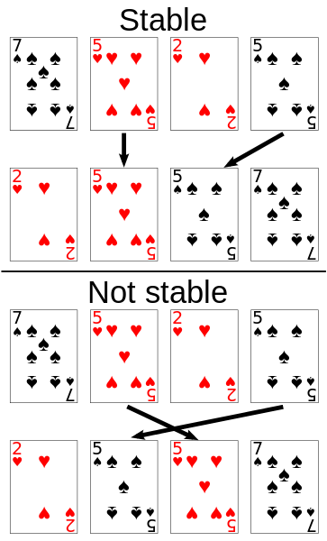
Stability of Sorting
Stable sorting algorithms
Maintain the order of equal elements
If two items compare as equal, their relative order is preserved
Unstable sorting algorithms
Rearrange the equal elements in unpredictable order
Often different elements have same key used for equality comparing

Slide 56
Bubble Sort
Bubble sort – simple, but inefficient algorithm (visualize)
Swaps to neighbor elements when not in order until sorted
Memory: O(1)
Stable: Yes
Method: Exchanging

Slide 57
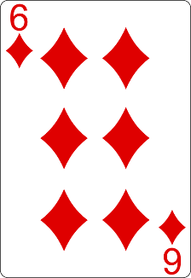
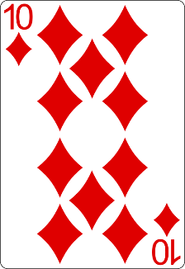
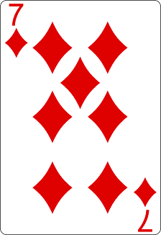
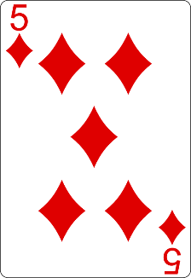
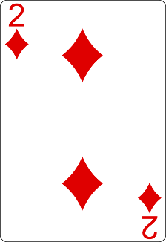
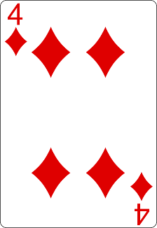
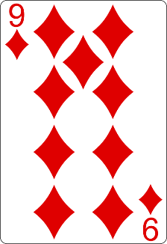
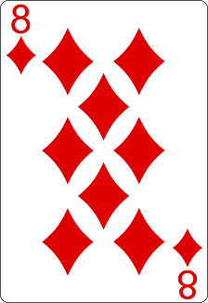
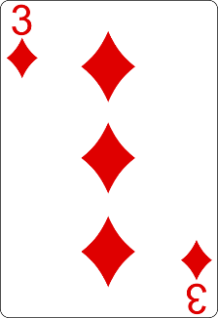
Bubble Sort Visualization
i
j

Slide 58
Bubble Sort Visualization
i
j

Slide 59
Bubble Sort Visualization
i
j

Slide 60
Bubble Sort Visualization
i
j

Slide 61
Bubble Sort Visualization
i
j

Slide 62
Bubble Sort Visualization
i
j

Slide 63
Bubble Sort Visualization
i
j

Slide 64
Bubble Sort Visualization
i
j

Slide 65
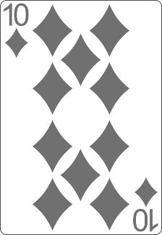
Bubble Sort Visualization
i
j

Slide 66
Bubble Sort Visualization
i
j

Slide 67
Bubble Sort Visualization
i
j

Slide 68
Bubble Sort Visualization
i
j

Slide 69
Bubble Sort Visualization
i
j

Slide 70
Bubble Sort Visualization
i
j

Slide 71
Bubble Sort Visualization
i
j

Slide 72
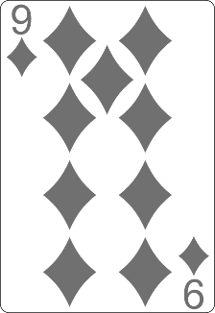
Bubble Sort Visualization
i
j

Slide 73
Bubble Sort Visualization
i
j

Slide 74
Bubble Sort Visualization
i
j

Slide 75
Bubble Sort Visualization
i
j

Slide 76
Bubble Sort Visualization
i
j

Slide 77
Bubble Sort Visualization
i
j

Slide 78
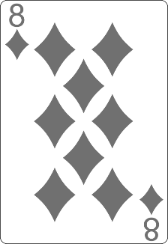
Bubble Sort Visualization
i
j

Slide 79
Bubble Sort Visualization
i
j

Slide 80
Bubble Sort Visualization
i
j

Slide 81
Bubble Sort Visualization
i
j

Slide 82
Bubble Sort Visualization
i
j

Slide 83
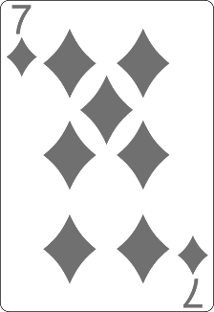
Bubble Sort Visualization
i
j

Slide 84
Bubble Sort Visualization
i
j

Slide 85
Bubble Sort Visualization
i
j

Slide 86
Bubble Sort Visualization
i
j

Slide 87
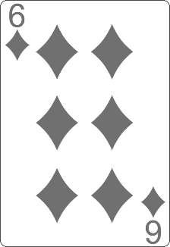
Bubble Sort Visualization
i
j

Slide 88
Bubble Sort Visualization
i
j

Slide 89
Bubble Sort Visualization
i
j

Slide 90
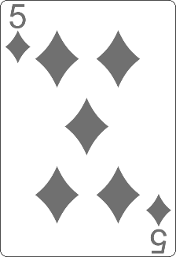
Bubble Sort Visualization
i
j

Slide 91
Bubble Sort Visualization
i
j

Slide 92
Bubble Sort Visualization

Slide 93
BubbleSort
Live Demo

Slide 94
BubbleSort
int[] numbers = { 1, 3, 4, 2, 5, 6 };
for (int i = 0; i < numbers.length; i++) {
for (int j = i + 1; j < numbers.length - 1; j++) {
if (numbers[i] > numbers[j]) {
int tempNumber = numbers[i];
numbers[i] = numbers[j];
numbers[j] = tempNumber;
}
}
}
//TODO: Print numbers

Slide 95


Searching Algorithms
Linear, Binary and Interpolation

Slide 96
Search Algorithm
Search algorithm == an algorithm for finding an item with specified properties among a collection of items
Different types of searching algorithms
For virtual search spaces
Satisfy specific mathematical equations
Try to exploit partial knowledge about a structure
For sub-structures of a given structure
A graph, a string, a finite group
Search for the min / max of a function, etc.

Slide 97
Linear Search
Linear search finds a particular value in a list (visualize)
Checking every one of the elements
One at a time, in sequence
Until the desired one is found
Worst & average performance: O(n)
for each item in the list:
if that item has the desired value,
return the item's location
return nothing

Slide 98
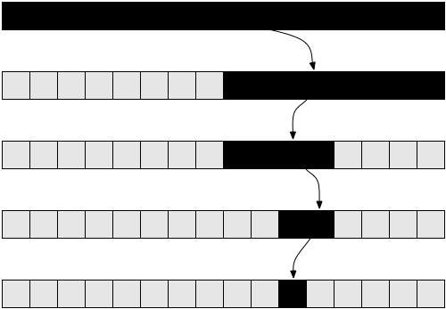
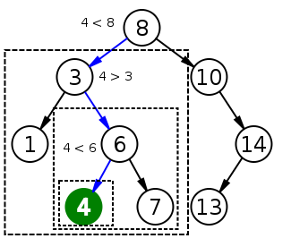
Binary Search
Binary search finds an item within a ordered data structure
At each step, compare the input with the middle element
The algorithm repeats its action to the left or right sub-structure
Average performance: O(log(n))
See the visualization

Slide 99
Binary Search (Iterative)
int binarySearch(int arr[], int key, int start, int end) {
while (end >= start) {
int mid = (start + end) / 2;
if (arr[mid] < key)
start = mid + 1;
else if (arr[mid] > key)
end = mid - 1;
else
return mid;
}
return KEY_NOT_FOUND;
}

Slide 100

Summary
Recursion - technique which usually involves a function calling itself
Brute-Force - trying all solutions
Greedy - picking locally optimal solution
Sorting
Bubble Sort
Searching
Linear
Binary
…
…
…

Slide 101
https://softuni.bg/trainings/courses

Slide 102













SoftUni Diamond Partners

Slide 103




SoftUni Organizational Partners

Slide 104




Trainings @ Software University (SoftUni)
Software University – High-Quality Education and Employment Opportunities
softuni.bg
Software University Foundation
http://softuni.foundation/
Software University @ Facebook
facebook.com/SoftwareUniversity
Software University Forums
forum.softuni.bg

Slide 105

License
This course (slides, examples, demos, videos, homework, etc.) is licensed under the "Creative Commons Attribution-NonCommercial-ShareAlike 4.0 International" license

